Slide 1




Slide 2
Sequence to sequence language model
Notes:
Hello and welcome, in this video we will start to dive into the components of the internal structure of transformers.

Slide 3
What will we discuss?
What are sequence to sequence transformer models?
How they work?
What is T5?

Slide 4
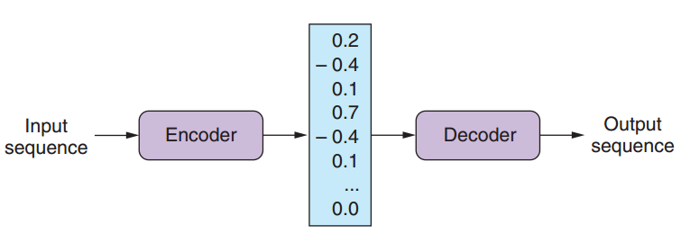
Sequence to sequence transformer
A sequence-to-sequence transformer model is a type of neural network that can transform one sequence of tokens (such as words or characters) into another sequence of tokens.
It consists of two main components: an encoder and a decoder.
(Figure adapted from Lane, Howard, & Hapke, 2019, p. 315)

Slide 5
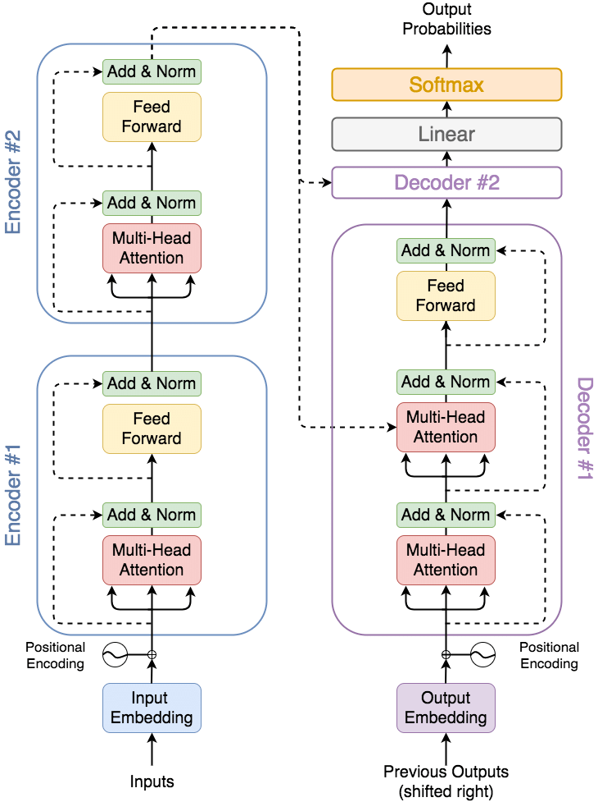
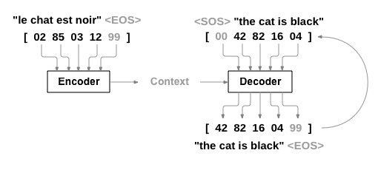
How it works?
It uses the original transformer architecture
The left encoder and the right decoder part of the transformer are connected with cross-attention.
Which helps each decoder layer attend over the final encoder layer.
This naturally pushes models toward producing output that closely tied to the original input .

Slide 6
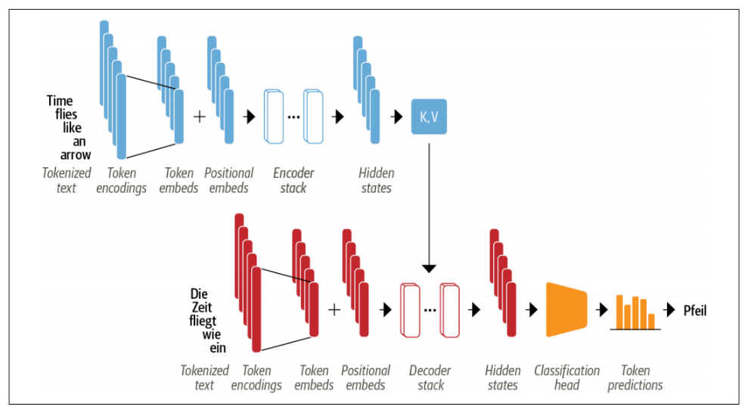
Seq-to-Seq schema
Input tokens → Embeddings → Encoder → Context → Decoder → Output tokens
Transformers
are
+
…
K,V
great
Token Embeddings
Positional Encoding
Encoding stack
Hidden state
Transformers
+
…
EOS
est
super
Figure adapted from Tunstall, von Werra, & Wolf, 2022, p. 58
Classification
head
Token Embeddings
Positional Encoding
Decoder stack
Hidden state
Token Prediction

Slide 7


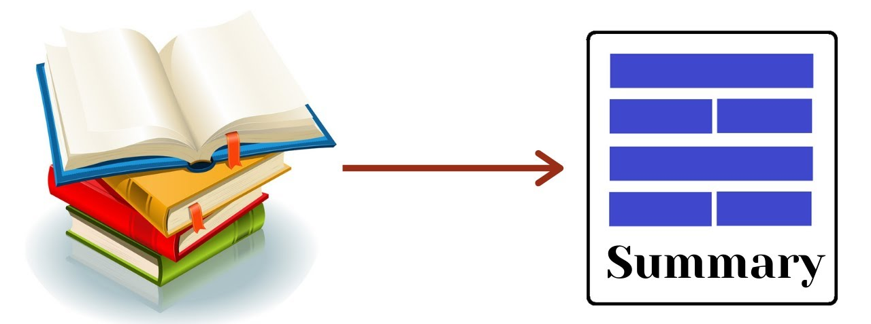

Advantages of seq2seq models
They can handle different types of tasks by simply changing the format of the input and output sequences.
An examples of seq2seq transformers:
T5
Bidirectional and Auto-Regressive Transformer (BART)
PEGASUS which stands for Pre-training with Extracted Gap-sentences for Abstractive Summarization Sequence-to-Sequence Models
Machine Translation
Question Answering
Text Generation
Text Summarization

Slide 8
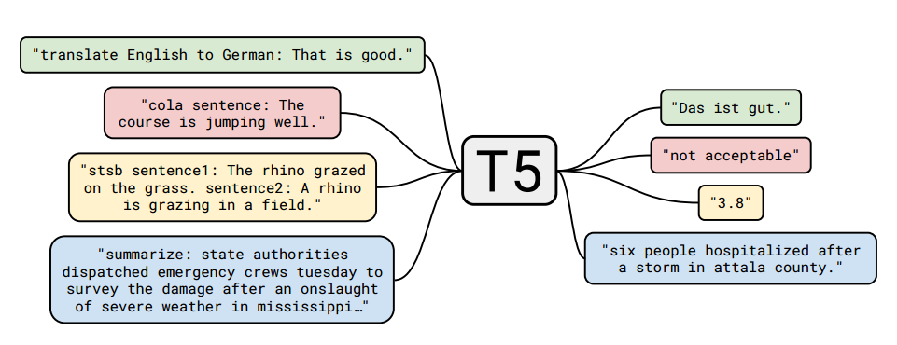
T5
T5 stands for Text-to-Text Transfer Transformer.
It is a neural network model that can handle any natural language processing tasks by casting them to a text-to-text problem.
T5 can translate between languages, answer questions, summarize documents, and classify sentences, just by changing the text prefix that tells it what to do.

Slide 9
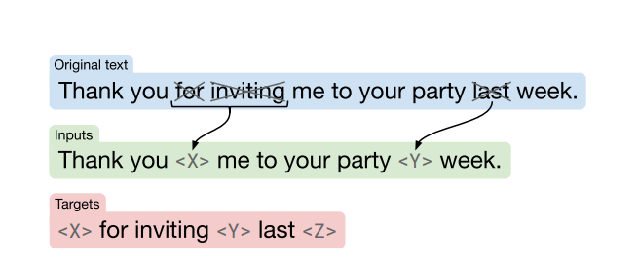
How T5 trained?
T5 was pre-trained on a large corpus of text called C4, which contains about 750 GB of clean and diverse web pages.
T5 learned to predict missing words in corrupted sentences, which is a self-supervised task that does not require any human labels.
T5 acquired a general understanding of natural language and its structure.

Slide 10
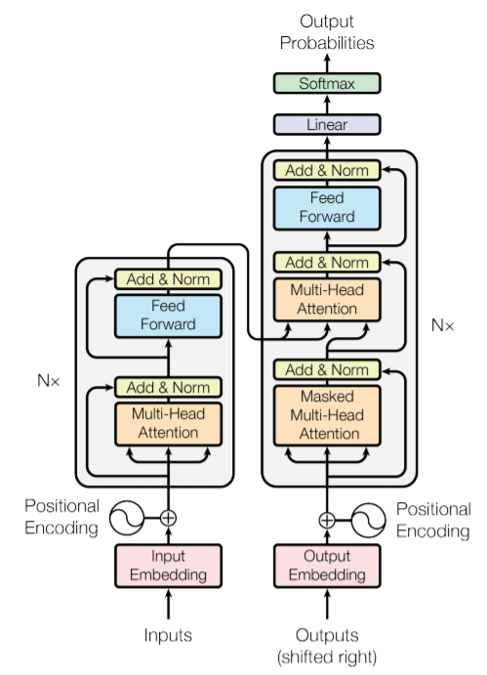
T5 Architecture
The T5 model follows the original encoder-decoder transformer model. The modifications are done in the layer normalization and position embeddings schema.
T5 uses a normalization layer that only scales and doesn’t shift the inputs → Root Mean Square Layer Normalization.
T5 uses relative positional embedding. that depends on the relative distance between two tokens rather than their absolute position in the sequence.
handle variable-length inputs and outputs without padding or truncation.
Relative positional embeddings also have some advantages over absolute positional embeddings:
better generalization to longer sequences.
better handling of shifted inputs.

Slide 11
Summary
T5 is a single model that can work on a diverse set of tasks such as language generation.
It casts tasks into a text-to-text format. The model is fed with text that is made up of a task prefix and the input attached to it. We convert a labeled textual dataset to a {'inputs': '....', 'targets': ...'} format.
We insert the purpose in the input as a prefix. Then, we train the model with labeled data so that it learns what to do and how to do it.

